Slide 1
我在LabmU的两年
陈光

Slide 2
Motivation
Learn?
Exp?
Social?

Slide 3

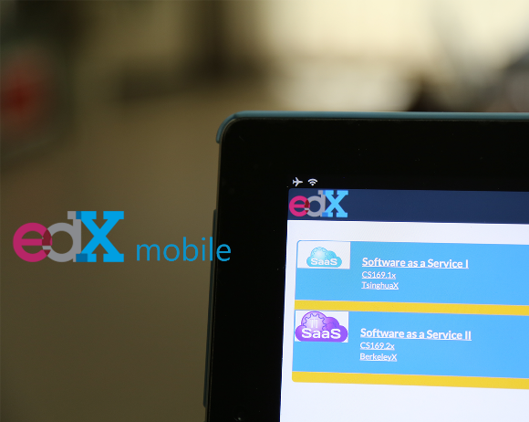
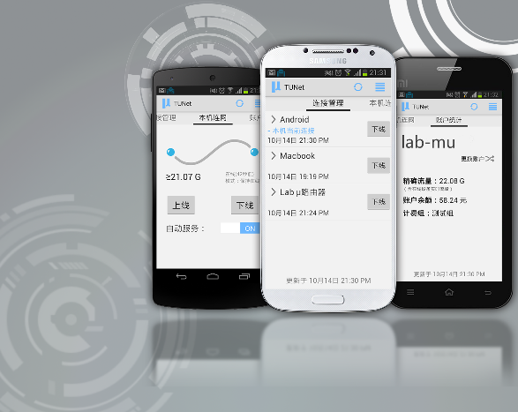
No matter whether you succeed or fail
Build
…

Slide 4
Let us arise !
？
Engineer
Be professional
Manager
Designer
Marketer
…

